Slide 1

KUMARAGURU COLLEGE OF TECHNOLOGY,
COIMBATORE - 641 049
(An Autonomous Institution Affiliated to Anna University, Chennai)
Department of Mechatronics Engineering
Project Phase – I

Slide 2
PERFORMANCE ANALYSIS OF AERIAL ROBOT MOTORS
Project Team:
1) | Bhairav Shakthi U E | 22BMC004
2) | Karthi M | 22BMC019
3) | Sankarasurya V | 22BMC041
4) | Yuvaraj M V | 22BMC063
Project Guide: Mr. Raffik R
Project Coordinator: Mr. Ramkumar A

Slide 3
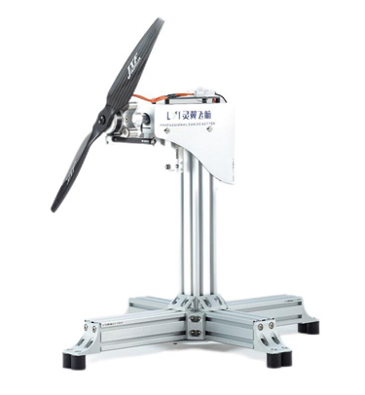
PROBLEM STATEMENT
Existing UAV motor test systems are costly and lack flexibility for different motors and load conditions. Their limited adaptability reduces testing accuracy and optimization. Hence, a compact, low-cost, and versatile test platform is needed for reliable motor performance evaluation.
OBJECTIVES
To design a low-cost and compact UAV motor testing platform.
To ensure flexibility for testing different motor types and load conditions.
To enable accurate and efficient evaluation of motor performance parameters.

Slide 4
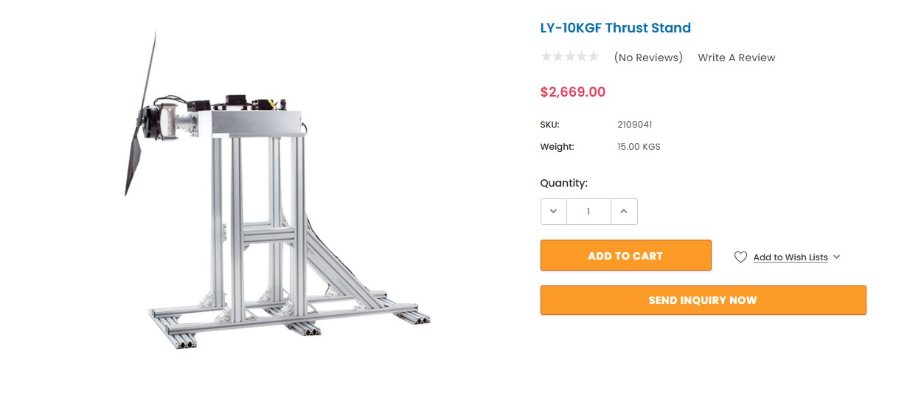
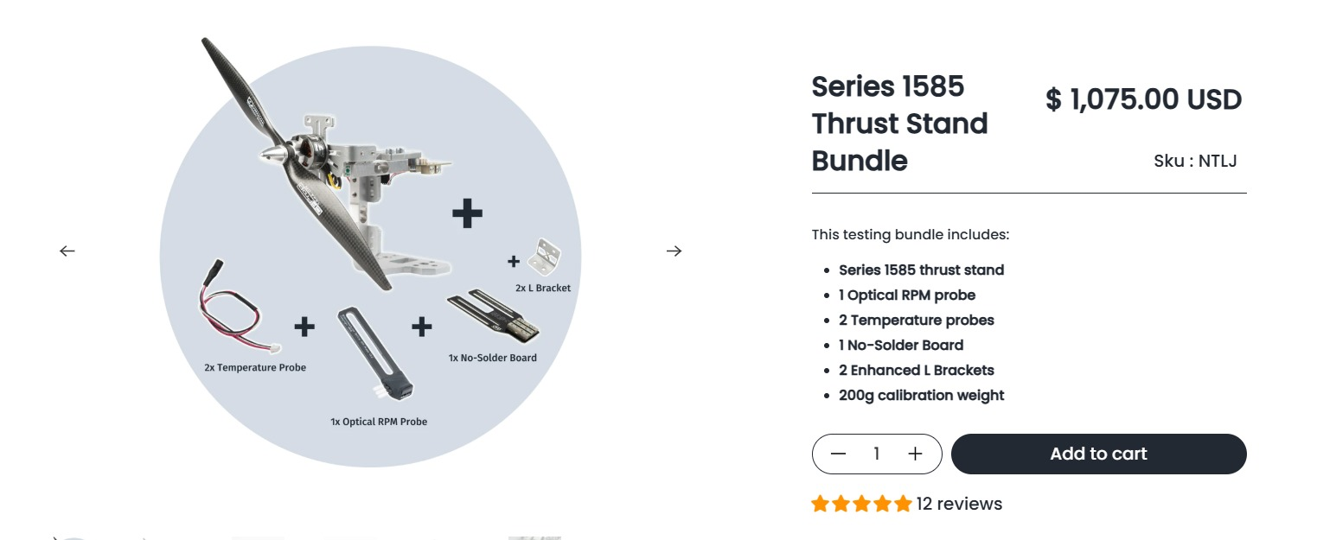
EXISTING PRODUCTS
LY-10KGF Thrust Stand — by WingFlying: powerful test bench for medium-sized UAV propulsion systems, up to 10 kgf thrust, 5 N·m torque, supports up to 30″ props, wide voltage/current range, suitable for larger drones.
Series 1585 Thrust Stand Bundle — by Tyto Robotics (former RCbenchmark): compact test stand for small to medium brushless motors/props, up to 5 kgf thrust, 2 N·m torque, designed for small drones, RC, UAV-R&D and propeller tuning.

Slide 5
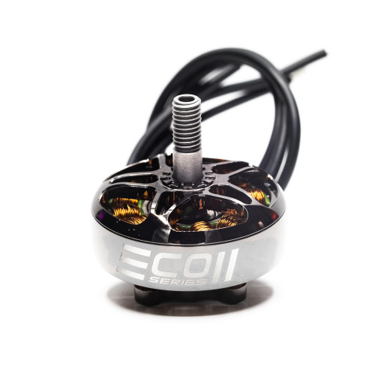
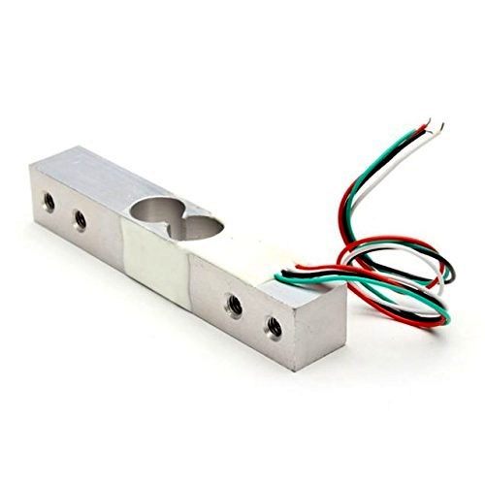
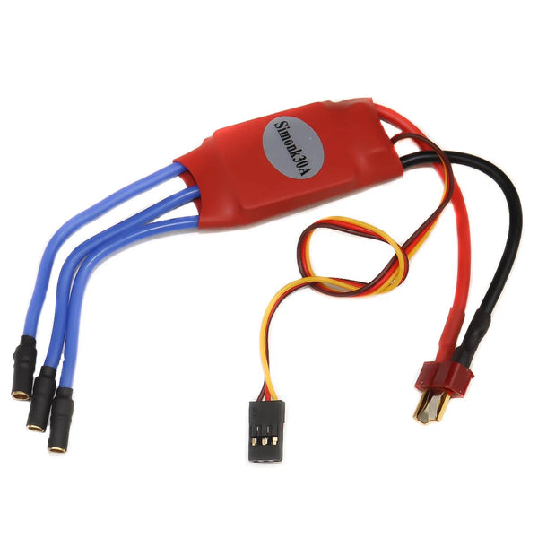
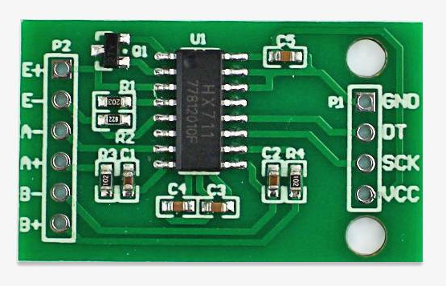
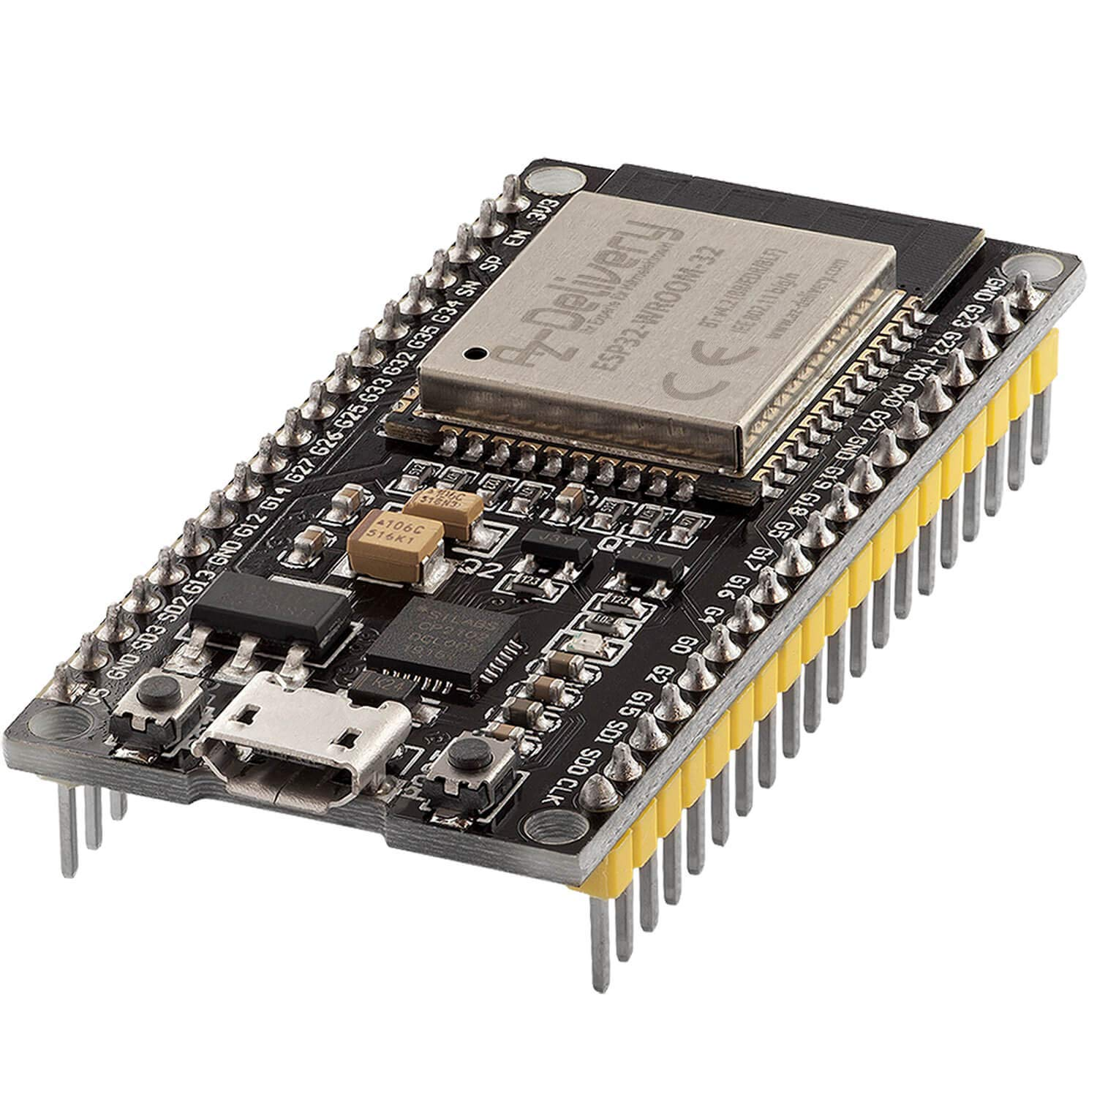
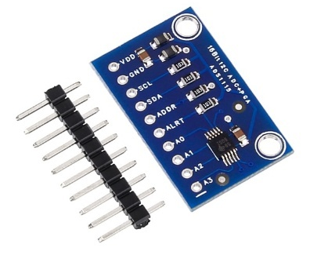
HARDWARE COMPONENTS
Electronic Speed Controllers (ESCs)
Power Module
Load Cell – HX711 Amplifier
ESP32
16-bit ADC Module

Slide 6
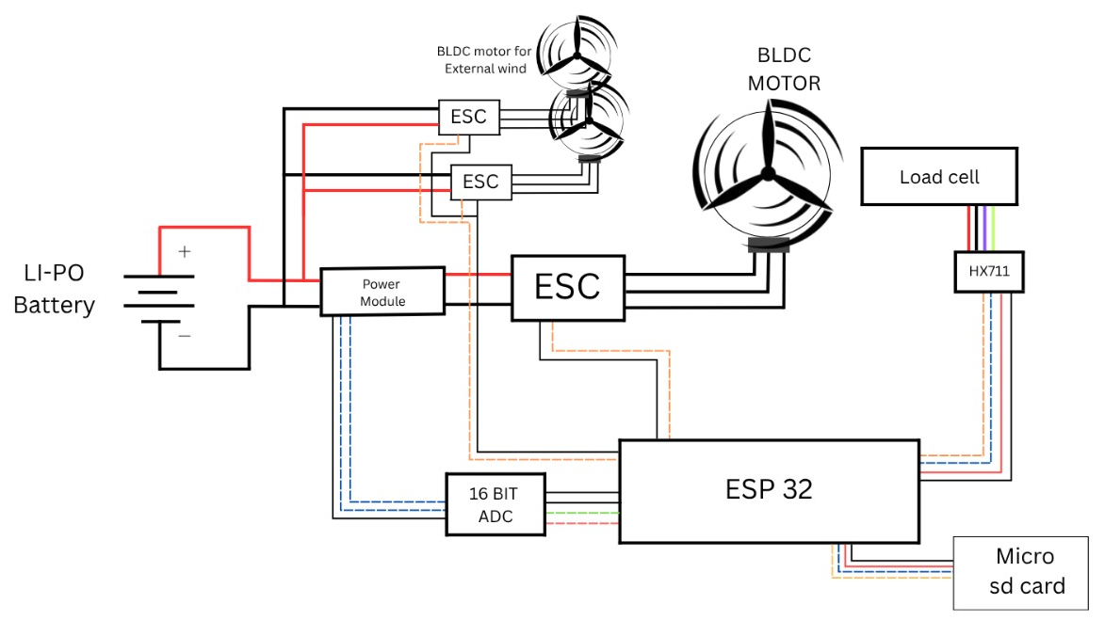
SYSTEM ARCHITECTURE

Slide 7
WORKFLOW
The BLDC motor is powered up through an Electronic Speed Controller (ESC) controlled by the microcontroller.
Thrust is measured using a load cell connected to the HX711 amplifier module.
Voltage and Current are monitored via a Power Module interfaced with 16-bit ADC for accurate readings.
ESP32 microcontroller handles motor control, sensor data processing, and logs result to the dashboard.

Slide 8
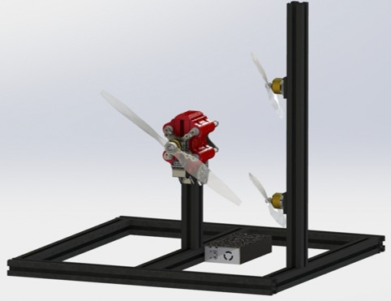
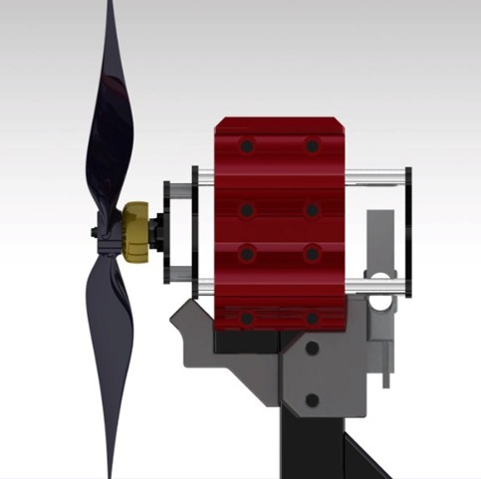
MECHANICAL DESIGN

Slide 9
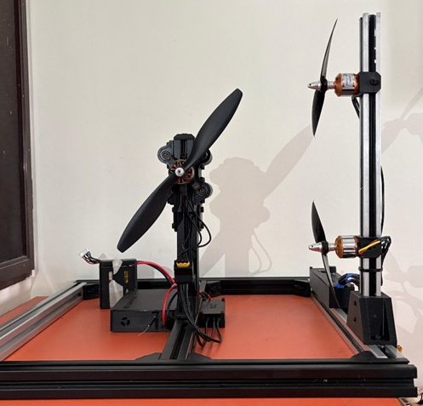
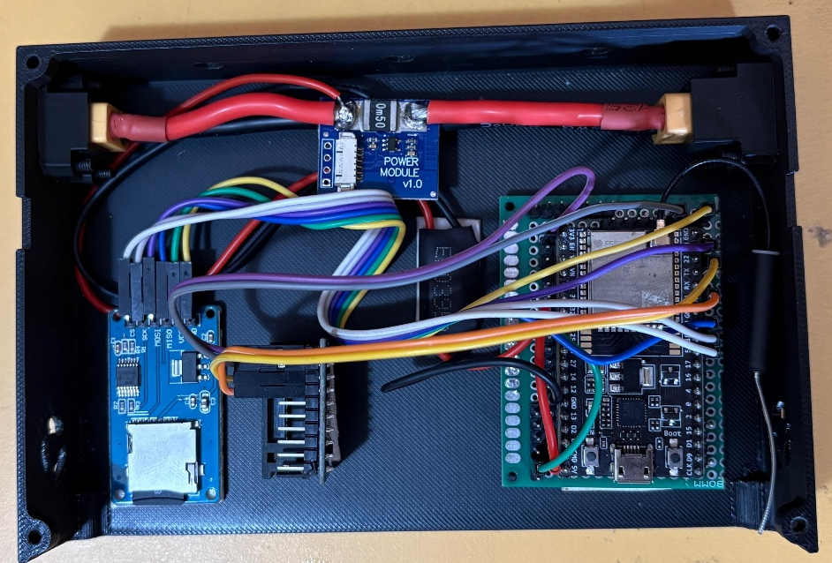
EXPERIMENTAL SETUP & CIRCUIT CONNECTION

Slide 10
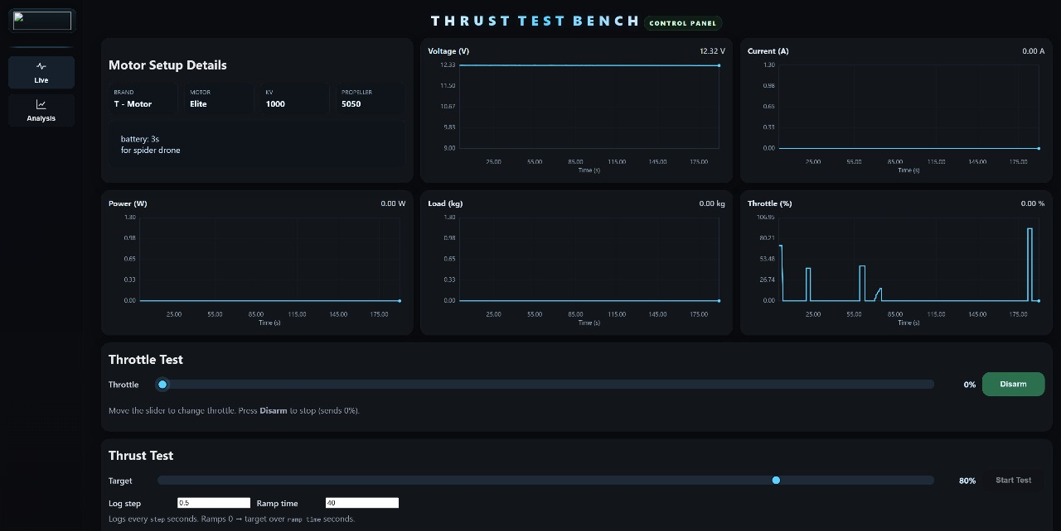
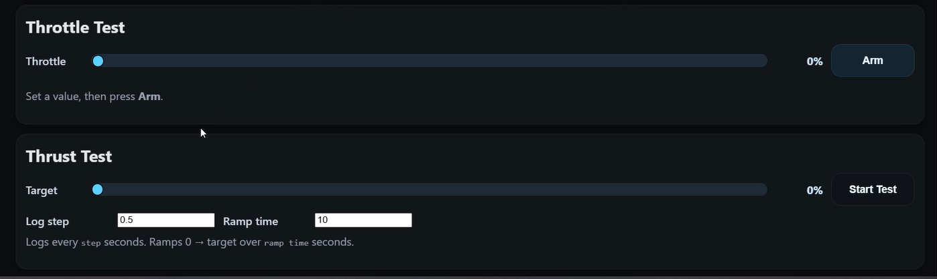
DASHBOARD AND CONTROL SYSTEM

Slide 11
EXPERIMENTAL TEST
Experimental testing was conducted on EMAX 1500 KV BLDC motor using a 10-inch propeller mounted on the developed thrust measurement rig.
The following are the performance parameters measured upto 40% throttle from the dashboard.
THROTTLE (in %) | VOLTAGE (in V) | CURRENT (in A) | THRUST (in kg) | POWER (in W)
10 | 18.477 | 0.364 | 0.084 | 6.726
20 | 18.36 | 2.313 | 0.283 | 42.467
30 | 18.138 | 6.111 | 0.577 | 110.842
40 | 17.797 | 11.809 | 0.957 | 210.165

Slide 12
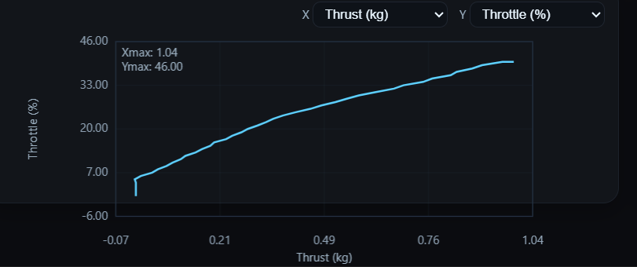
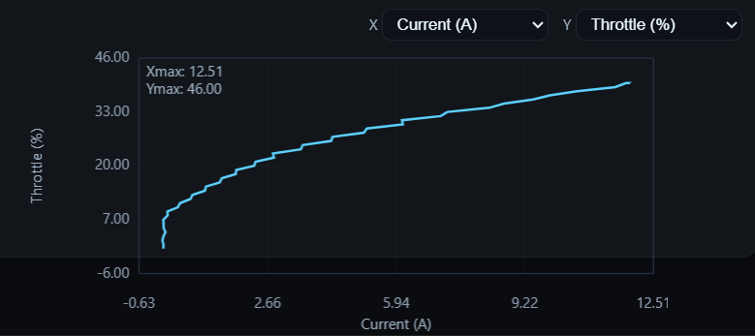
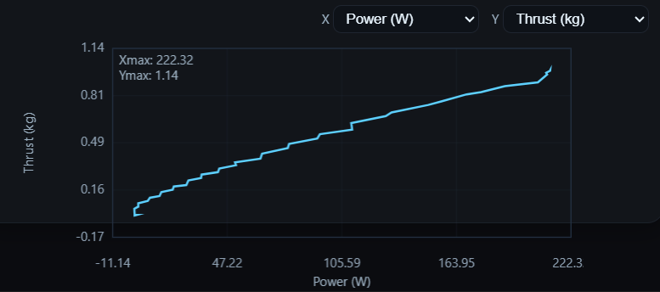
PERFORMANCE ANALYSIS
The graphs show the relationship between throttle input and key performance parameters such as thrust, current, and power.
The results indicate smooth and consistent performance across the operating range, confirming reliable motor–propeller behavior.

Slide 13
ADVANTAGES
Compact and lightweight design suitable for laboratory or field use.
Low-cost setup using easily available components.
High accuracy in measuring thrust, voltage, current, and RPM.
Real-time data monitoring and visualization through a user-friendly dashboard.
Flexible design compatible with various BLDC motors and propeller types.
Reliable and repeatable performance testing for consistent results.
Easy data logging and analysis for efficiency evaluation

Slide 14

FUTURE SCOPE
The system can be further enhanced by
Automating the entire testing and data acquisition process to improve efficiency and accuracy.
Integration of advanced sensors can enable additional performance metrics such as vibration and noise.
Cloud-based analytics for remote monitoring and comparative performance studies.

Slide 15


Slide 16
CONCLUSION
The developed test bench measures key performance parameters and optimal operating conditions for different propeller configurations.
Its compact and low-cost design makes it suitable for both commercial use and research.
Overall, the project demonstrates a reliable and effective platform for evaluating and improving aerial robot propulsion systems.

